Slide 1

JTI TME Project
Date : 15th December 2008

Slide 2
JTI Client Background
JTI stands for Japan Tobacco International
3rd largest international tobacco manufacturer in the world with 11% market share
Formed in 1999 when acquired internal operations of R.J.Reynolds
In 2007, JTI expanded further their activities by acquiring and integrating Gallagher
International production, marketing and sales
Headquartered in Geneva with a presence in 40 countries and 30 factories around the world
90 different cigarette brands are sold in over 120 different countries
Fortune’s Global 500 company
Employs 23,000 people
385 billion cigarettes - US$8 billion net sales
Top brands include Camel, Winston and Mild Seven
Notes:
JTI - Japan Tobacco International is the international tobacco business of Japan Tobacco, the world's third largest industry player, with a global market share of 11% and market capitalization of approximately USD 50 billion.
The group was formed in 1999 when Japan Tobacco Inc. purchased, for USD 8 billion, the international tobacco operations of the US multinational R.J.Reynolds.
In 2007, Gallaher, a FTSE 100 business, was acquired by Japan Tobacco for GBP 9.4 billion. At the time, this was the largest foreign acquisition by a Japanese company.
In 2009, we will enter our 10th year. We are a young industry player built on solid tobacco experience and rich heritage, dating back to the 18th century.

Slide 3


JTI Tobacco Brands

Slide 4
TME Programme Background
TME stands for Trade Marketing Excellence
Initiated because of new restrictions and regulations in tobacco advertising
Marketing tool aimed at
  Helping Trade Marketer in their field activities at outlets in completing marketing, sales, retail audit, merchandising and promotions activities
  Performing long term reconciliation and analysis of data for forecast and action plans
  Ensuring revenue growth with optimized and more efficient method of advertising
  Dealing with increasing competition among the top 3 big players in the tobacco industry
  Increasing local and global market share
  Standardizing trade marketing best practices globally

Slide 5




Tool usage by Trade Marketing role
Central
Field
Portfolio &
Brand Strategy
Development
& Planning
C&TM
Operations
District/Sales Area
Management
C&TM Strategy
Consumer–Trade
Channel Planning*
Operational
Planning
Merchandising
Trade Marketing
Programme
Development
Sales
TM roles
Brand Manager
Channel Manager
Segment Manager
Account Manager
Category
Developer
Operational Planner
District/Area Sales Manager
Trade Marketer
Merchandiser

Slide 6


TME Architecture
Execution
Strategic
TME
LAPTOP
ETL
Transactional
data
Analytical
data
Siebel Sales
Analytics
& Segmentation
Siebel Analytics

Slide 7
JTI TME - Accenture Context
Long term programme scheduled over two phases starting as from 2002
  Phase 1: Implementation of BI analysis tool
  Phase 2: Implementation and deployment of TM best practices on mobile clients
Engagement Partner: W. Buttiens
Phase 1
  Consisted only of Siebel Analytics and ETL transfer functionalities
  Phase Out in June 2008
  Deployed over 12 markets
Phase 2
  Consists of Siebel OLTP, Analytics and ETL
  Successfully deployed pilot for two markets in Q1 2006
  Successfully deployed in over 14 markets
Notes:
In the Phase 1 system, the data from flat file are loaded directly into ETL database and then reports are then executed from Siebel Analytics.

Slide 8
TME Track Record @ MIDC
Project started at MIDC in March 2005
Gradually took over support for Phase 1 application from onshore (Accenture Belgium) as from May 2005
In January 2006, first go-live for the Phase 2 project was performed for the first two pilot markets Spain and Italy market
Completed transition in August 2006 (full support provided from offshore)
Key deliverables
  Completed the deployment of 9 markets in Phase 1
  Completed the deployment of 14 markets in Phase 2
  Implemented task force for improving application performance
  Completed implementation of major new functionalities

Slide 9
New Project Organization Structure for 2009
Michel Ah-See
Offshore Lead
Application Maintenance
Market Operations
Philippe Dirlewanger
AM Manager
Brinsley Gungadoo
MO Manager
Sales SME
Analytics SME
Data SME
Data Ops SME
Data SME
Tech Arch
JC Arlanda
3 FTE
(until April)
Development resource pool
7 FTE
Market Operations
resource pool
6 FTE
Change ~ 60%
Incident ~ 40%
Improvement Plan
3 FTE (tbc)

Slide 10
TME Core Team [1]
Sales
  Development and issue resolution in Siebel Sales application
Analytics
  Creation of Siebel Analytics dashboard
  Configuration of the JTI business analytical data model in Siebel Analytics repository
Data
  Development of ETL from Siebel Sales to Siebel Analytics
  Implementation of batches for data generation
  Creation of interfaces for data loads from flat files

Slide 11
TME Core Team [2]
Market Operations Support
  Monitoring of daily night data processes
  Execution of batches for data generation
  Perform flat file loads
  Issue investigation resulting from flat file loads ad batch execution
Technical Architecture
  Upgrade of Technical Environment and Siebel Application
  Application Monitoring & Support
  Preparation and deployment of Application Releases
  Issue investigation and resolution

Slide 12




















TME Support Model
GSD
COE
GDC-Siebel
GTC
Accenture Offshore Support

Slide 13
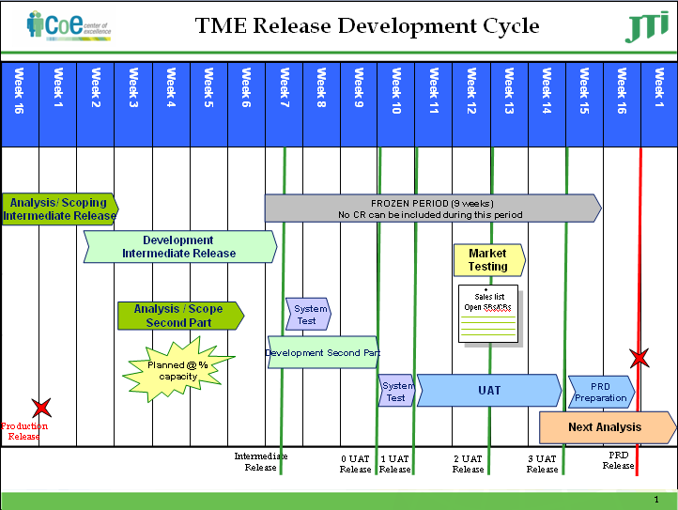
Process Followed – Change Management

Slide 14
Process Followed – Incident Management
Service Requests are handled through priority assigned to them defined as follows:-
  Criticality Level 5 - P1 – To Be Completed within 1 Service Hour & P2 – To Be Completed within 2 Service Hours
  Criticality Level 4 - P4 – To Be Completed within 4 Service Hours
  Criticality Level 3 - P8 – To Be Completed within 8 Service Hours & P9 – To Be Completed within 9 Service Hours
  Criticality Level 2 - P16 –To Be Completed within 16 Service Hours
  Criticality Level 1 - P40 – To Be Completed within 40 Service Hours
  Criticality Level 0 – above P40
SLA defined on
  Resolution time
  Response time
  Progress updates
Support hours are from 0700 CET to 1900 CET
  Span over two to three shifts from 0830 MRU to 2300 MRU

Slide 15

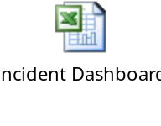
Reporting & Metrics
Development Status Report
  Track development status in terms of burned capacity, remaining capacity and percentage completion
Incident Dashboard
  Monitor and track incident backlog level

Slide 16

THANK YOU

